Slide 1
Statistical Techniques for Data Mining

Slide 2
Goals
Learn the Bayes Classifier
Survey basic statistical concepts and see how statistical tools can be used for data mining
  Supervised
  Unsupervised (-)
Compare statistical methods with the others we have seen so far

Slide 3
Statistician’s Point of View
“The data mining algorithm used in the winning entry was standard Naive Bayes learning. The second best entry... also used a Naive Bayes classifier. Many of the methods described in the 29 reports by participants are much more sophisticated. They include combinations of back propagation neural networks, self-organizing maps, evolutionary algorithms, C4.5, CART, and other decision tree algorithms, fuzzy clustering and rule discovery, support vector machines, logistic regression, boosting and bagging and more. The strong performance of naive Bayesian learning against this competition is noteworthy.”
Charles Elkan, in “Magical Thinking in Data Mining: Lessons from CoIL Challenge 2000.”
Although this might be too strong a statement, statistical methods are still among the most commonly used in practice of data mining.

Slide 4
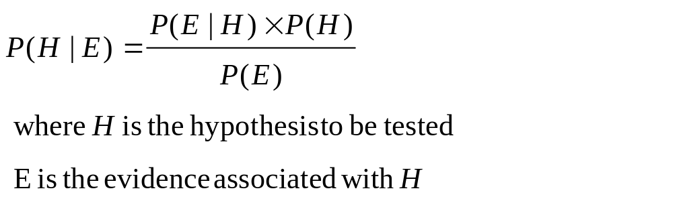
Bayes Classifier
Simple but very effective classification technique
Based on Bayes Theorem
Used extensively in Decision Analysis to “reverse” the sequence of events in conditional probabilities

Slide 5
Bayes Theorem: An Example
Most medical tests are not 100% accurate. From clinical tests, error rates for false prediction are known.
  For instance, test X detects hep. B with 95% success if the virus is present (5% false negative rate). Test X predicts hep. B in a person who does not have the virus with 1% probability (1% false positive rate).
  Given you test positive for hep. B, what is the probability that you really have the virus?
  P(Virus | +) = P(+ | virus)*P(virus) / P(+)
  P(+) = P(+|virus)*P(virus) + P(+|no virus)*P(no virus)

Slide 6
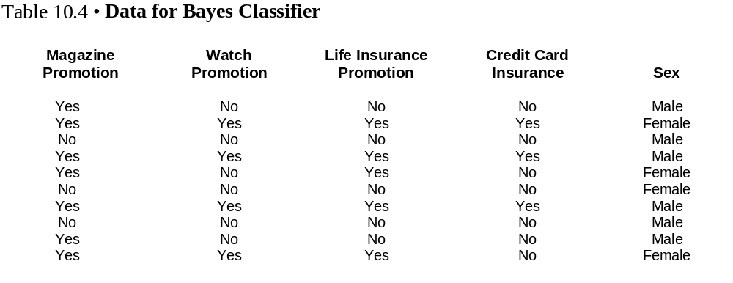
Bayes Classifier: An Example

Slide 7
The Instance to be Classified
Magazine Promotion = Yes
Watch Promotion = Yes
Life Insurance Promotion = No
Credit Card Insurance = No
Sex = ?
Compute: P(Sex=F | E) and P(Sex=M | E)
Pick the most likely outcome as the computed class.
E

Slide 8
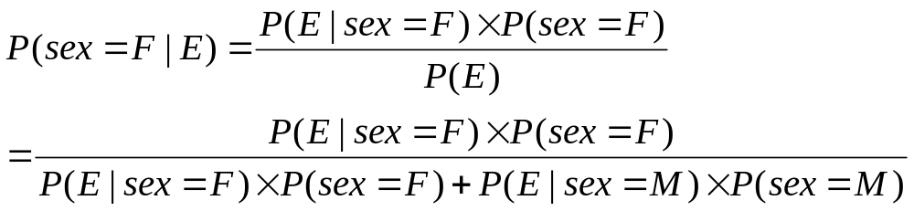
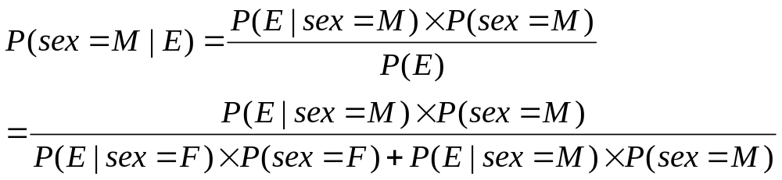
Bayes Formulas

Slide 9
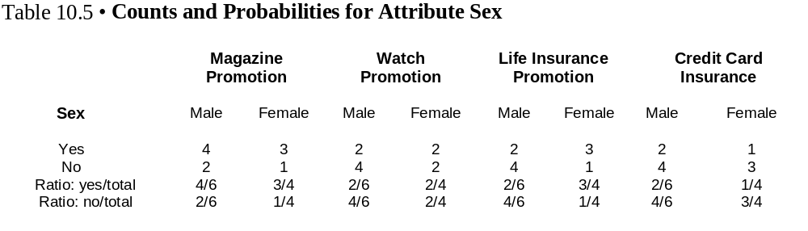
Computations

Slide 10
Bayes_ex.xls
Conditional Probabilities for Sex = Male
  P(magazine promotion = yes | sex = male) = 4/6
  P(watch promotion = yes | sex = male) = 2/6
  P(life insurance promotion = no | sex = male) = 4/6
  P(credit card insurance = no | sex = male) = 4/6
  P(E | sex =male) = (4/6) (2/6) (4/6) (4/6) = 8/81

Slide 11
Computations
P(sex = female| E) ≈ 0.0281 / P(E)
P(sex = male | E) ≈ 0.0593 / P(E)
Conclusion: Instance is approximately twice as likely to be male.

Slide 12
Implementation Issues: “zero probabilities”
Bayes classifier requires simple computations; however, when a component probability happens to be zero in the numerator, it kills the computations.

Slide 13
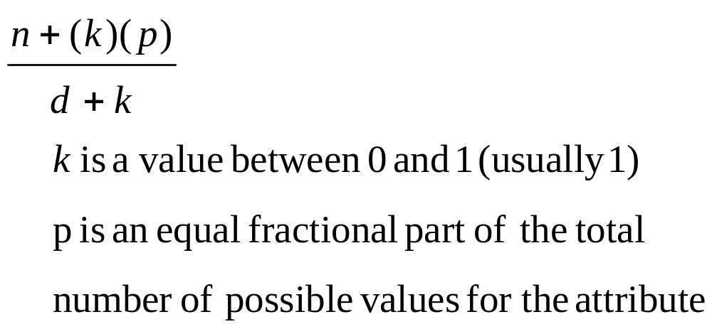
Dealing with Zero-Valued Attribute Counts
When computing probabilities based on counts, add a constant k to both numerator and denominator.

Slide 14
Dealing with Missing Data
With Bayes classifier missing data items are ignored.
  Given instance I with
    Magazine Promotion = yes
    Watch Promotion = unknown
    Life Insurance Promotion = no
    Credit Card Insurance = no
    Sex = ?
  Ignore watch promotion when computing conditional probabilities. This affects both Female and Male probability computations.

Slide 15
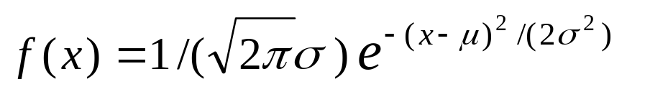
Dealing with Numeric Data
When an input attribute is numerical, conditional probabilities cannot be computed as before.
Bayes Classifier assumes a (normal) distribution for the attribute.
where
  e = the exponential function
  μ = the class mean for the given numerical attribute
  σ = the class standard deviation for the attribute
  x = the attribute value
μ and σ are estimated from the data

Slide 16
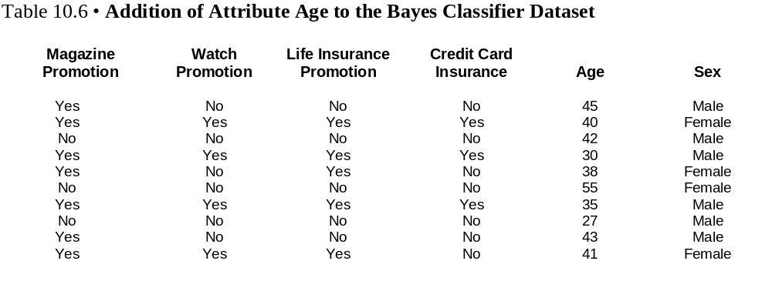
Example

Slide 17
Suppose we are given the following instance to classify:
  Given instance I with
    Magazine Promotion = yes
    Watch Promotion = yes
    Life Insurance Promotion = no
    Credit Card Insurance = no
    Age = 45
    Sex = ?

Slide 18
Bayes_ex.xls
As with categorical attributes, we have to compute
  P(age=45|F) and P(age=45|M)
  We compute these probabilities by using the probability density function (plug in 45 for x) using the class mean and standard deviation for F and M respectively .

Slide 19
Using WEKA
WEKA supports the Bayes classifier.
  Naive Bayes
The WEKA output for the credit card example displays a 70% accuracy on the training set. CC_Bayes_run.doc

Slide 20
Linear Regression Analysis
Given all numerical input attributes x₁,.., x_{n}, the general linear regression equation can assign a predicted value to this instance:

Slide 21
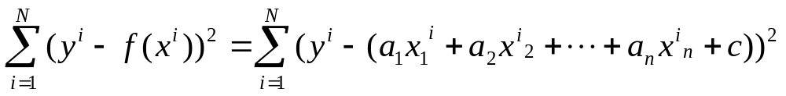
Linear Regression: Brief Overview
Given a set of instances with attribute values x^{i} =(x^{i}₁, x^{i}₂,...,x^{i}_{n}, y^{i}) where y^{i} denotes the output attribute, i=1,..N,
The regression approach finds the parameters so as to minimize the total sum of squared errors (SSE):

Slide 22
Linear Regression-ct’d
Therefore, finding the regression equation, i.e. finding the coefficients a₁,..a_{n} and the constant c is an optimization problem with special structure and can be obtained as a closed form solution.

Slide 23
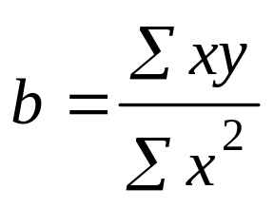
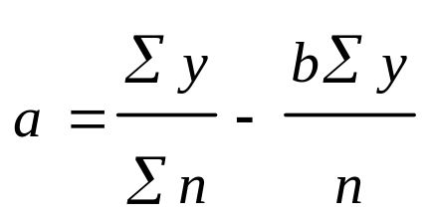
Simple Linear Regression
When there is one input and one output, the formulas for a and b are given by:

Slide 24
Multiple Linear Regression with Excel
Equivalently, Excel has a simple (yet effective) built-in regression tool that can be used:
    Tools->Data Analysis->Regression
    Select the input attribute range as independent variables
    Select the output attribute range as the dependent variable

Slide 25
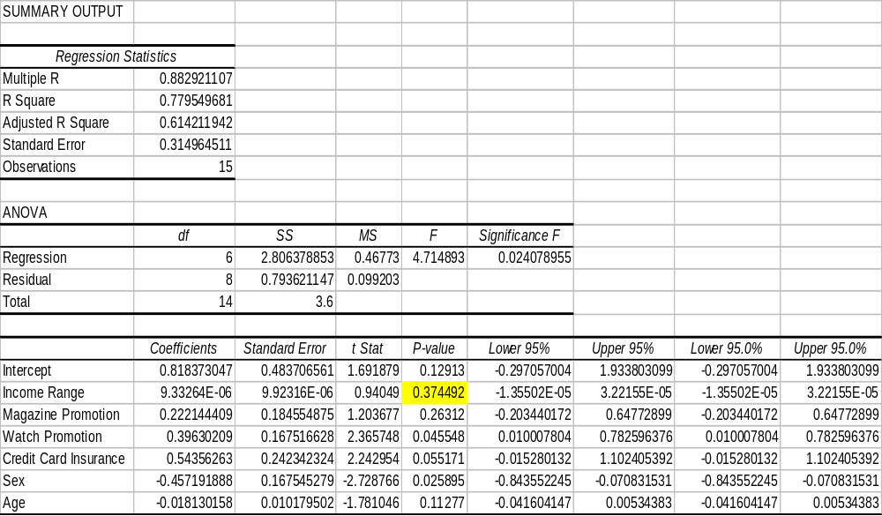
Excel Output

Slide 26
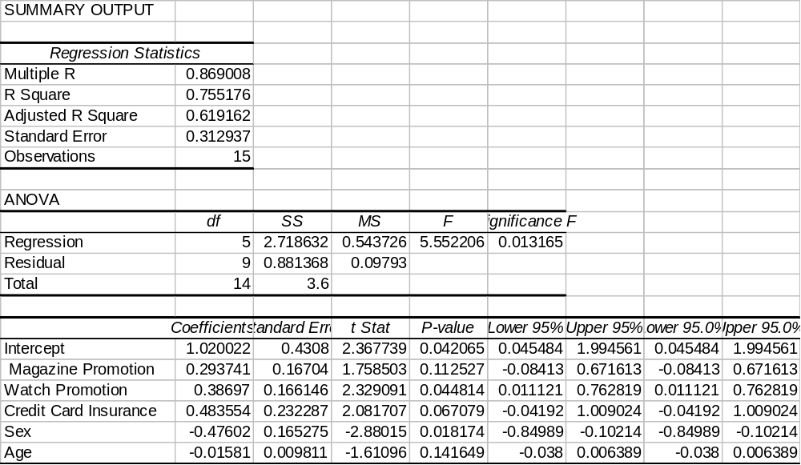
Excel Output: Dropping Income Range

Slide 27

Weka Output (Classification with Linear Regression)
=== Classifier model (full training set) ===
Linear Regression Model
Life Ins Promotion =
0.2937 * Magazine Promotion +
0.387 * Watch Promotion +
0.4836 * Credit Card Insurance +
-0.476 * Sex +
-0.0158 * Age +
1.02
Time taken to build model: 0 seconds
=== Evaluation on training set ===
=== Summary ===
Correlation coefficient 0.869
Mean absolute error 0.1918
Root mean squared error 0.2424
Relative absolute error 39.9616 %
Root relative squared error 49.4797 %
Total Number of Instances 15

Slide 28
Regression Trees
Similar to decision trees where the leaf nodes have numeric values rather than categorical
Model Trees: A collection of conditional linear regression models where each leaf node contains a particular model
This makes it possible to capture nonlinear relationships (provided that local linear relationships can be built)

Slide 29
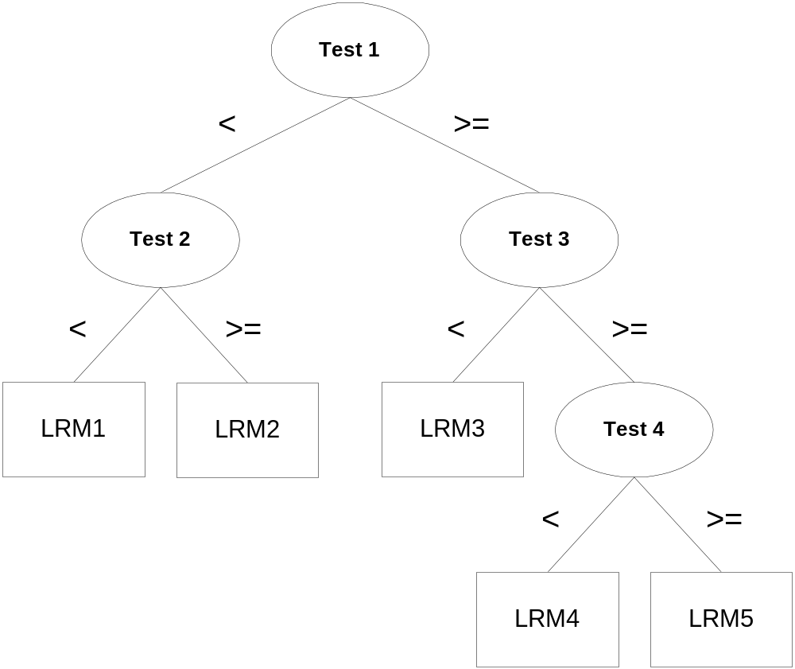
A Generic Model Tree

Slide 30
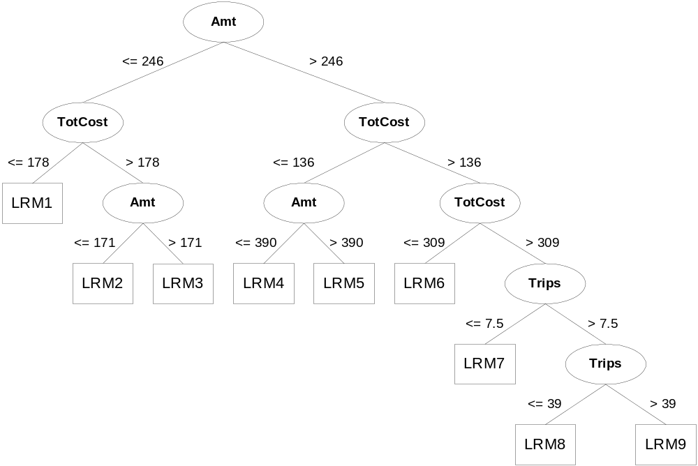
Model Tree for the Deer Hunter Dataset complete_modeltree_byWeka.doc

Slide 31
Logistic Regression
Statisticians addressed the classification problem way before the term data mining was used.
Although their approach in dealing with categorical values can be mostly captured by our simple Credit Card Promotion example, they devised Logistic Regression to refine the approach and to eliminate some obvious shortcomings such as predicting out of range (invalid) values.

Slide 32
Transforming the Linear Regression Model
Logistic regression is a nonlinear regression technique that associates a conditional probability with each data instance.

Slide 33
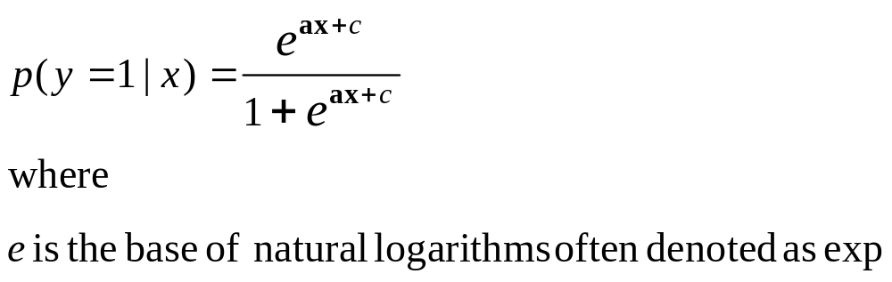
The Logistic Regression Model

Slide 34
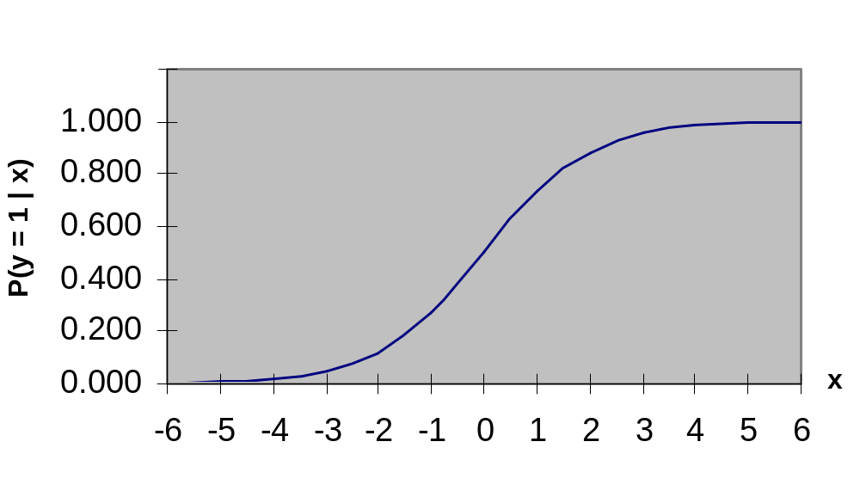

Slide 35
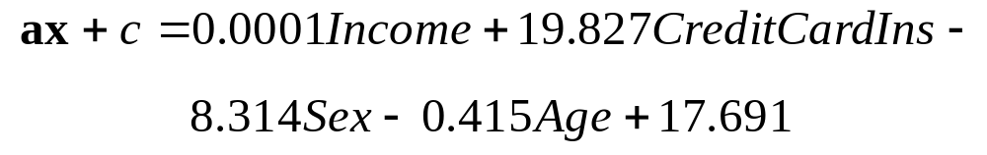
Logistic Regression: An Example
The Credit Card Promotion database with magazine promotion and watch promotion removed and income converted to numeric

Slide 36
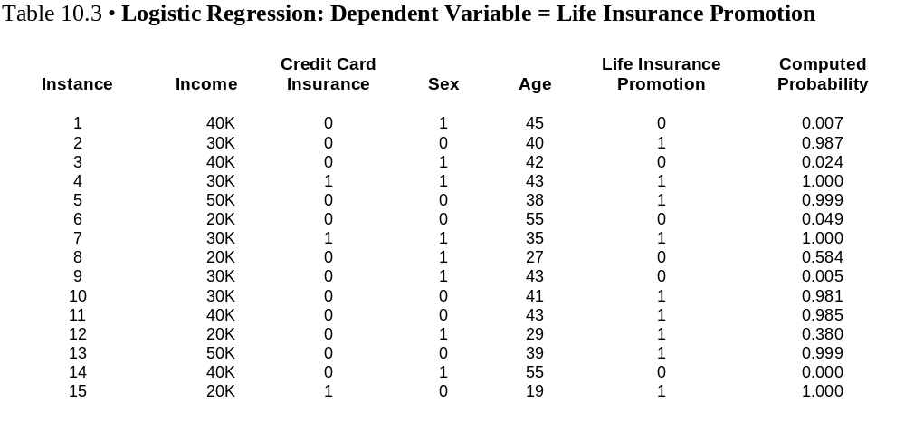

Slide 37
Logistic Regression by WEKA
CC_Promotion_WEKA_LogisticR.doc
Coefficients...
Variable Coeff.
1 0.0001 (Income)
2 18.5949 (Credit Card Insurance)
3 -8.3143 (Sex)
4 -0.4152 (Age)
Intercept 17.691

Slide 38
Clustering Algorithms
Agglomerative Clustering
Conceptual Clustering (COBWEB)
Expectation Maximization (EM)
We will not cover these clustering techniques.
COBWEB and EM are supported by WEKA.

Slide 39
Machine Learning and Statistical Techniques
Statistical techniques typically assume an underlying distribution for the data whereas machine learning techniques do not.
Machine learning techniques tend to have a human flavor.
Machine learning techniques are better able to deal with missing and noisy data (Neural Networks).
Most machine learning techniques are able to explain their behavior.

